Slide 1
ShopEasy Business Case
Marketing Data Analysis
-Saurav Ghag

Slide 2
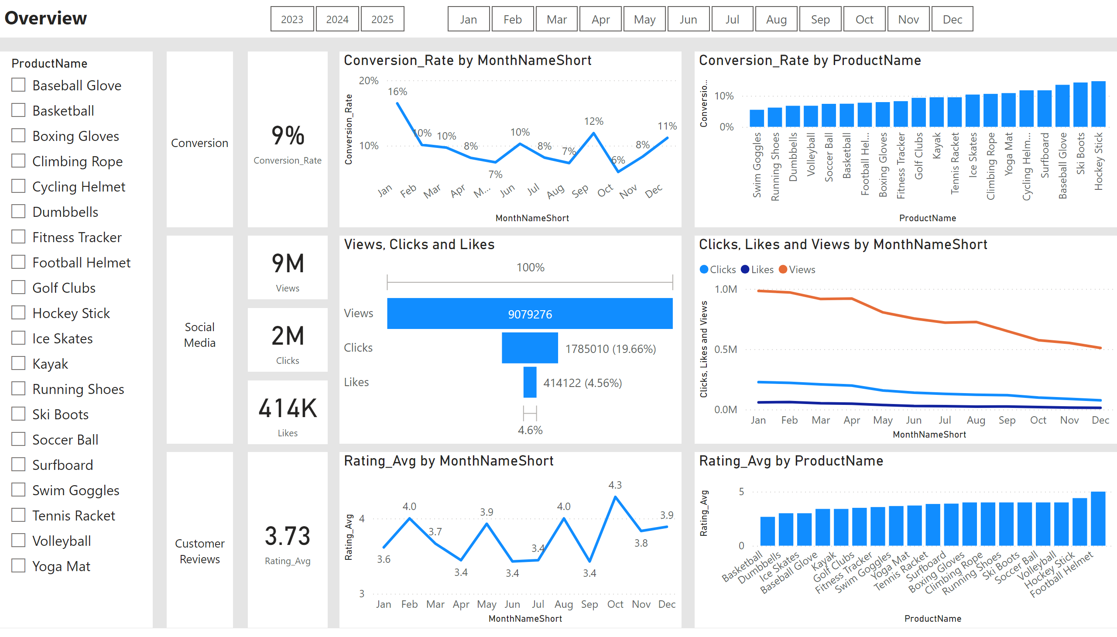
Overview
Notes:
textbox
No alt text provided
slicer
No alt text provided
textbox
No alt text provided
textbox
No alt text provided
textbox
No alt text provided
card
No alt text provided
card
No alt text provided
card
No alt text provided
card
No alt text provided
card
No alt text provided
slicer
No alt text provided
slicer
No alt text provided
lineChart
No alt text provided
clusteredColumnChart
No alt text provided
lineChart
No alt text provided
funnel
No alt text provided
lineChart
No alt text provided
clusteredColumnChart
No alt text provided

Slide 3
You can see the overview of conversion rate, social media interactions such as views, clicks. Likes and customer reviews with average customer ratings.
These overview of marketing data is from year 2023 to 2025

Slide 4
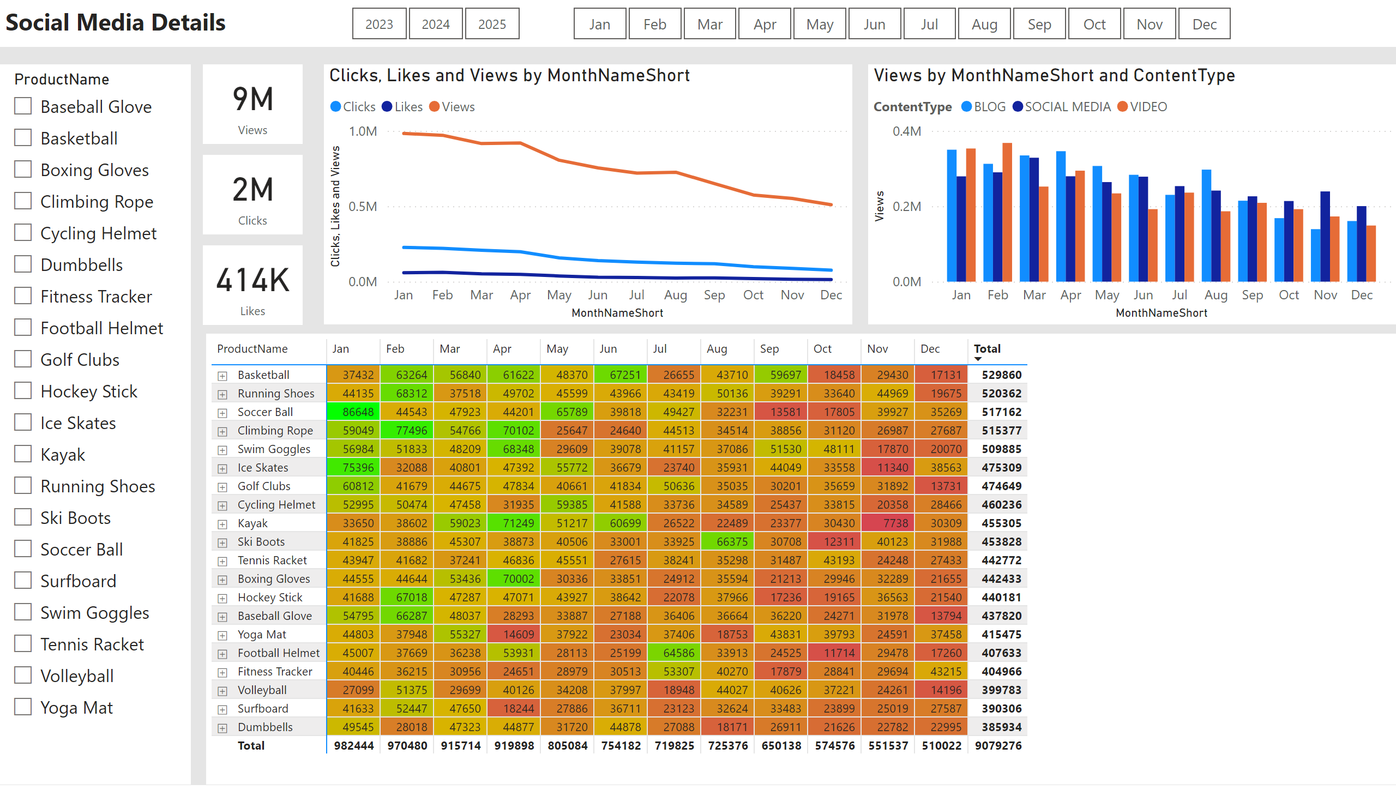
Social Media Details
Notes:
textbox
No alt text provided
slicer
No alt text provided
card
No alt text provided
card
No alt text provided
card
No alt text provided
slicer
No alt text provided
slicer
No alt text provided
lineChart
No alt text provided
clusteredColumnChart
No alt text provided
pivotTable
No alt text provided

Slide 5
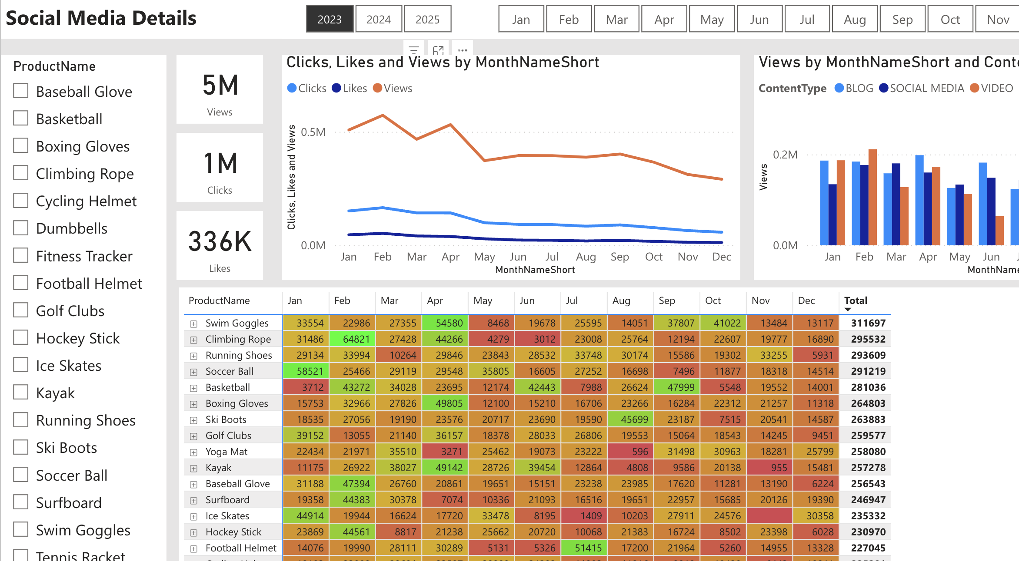
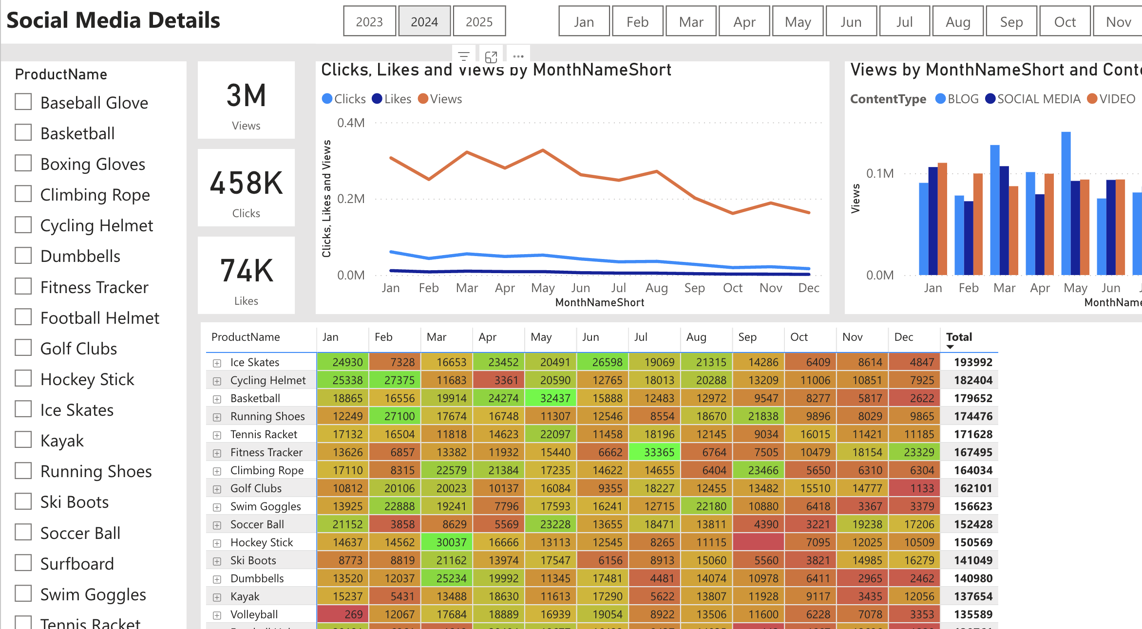
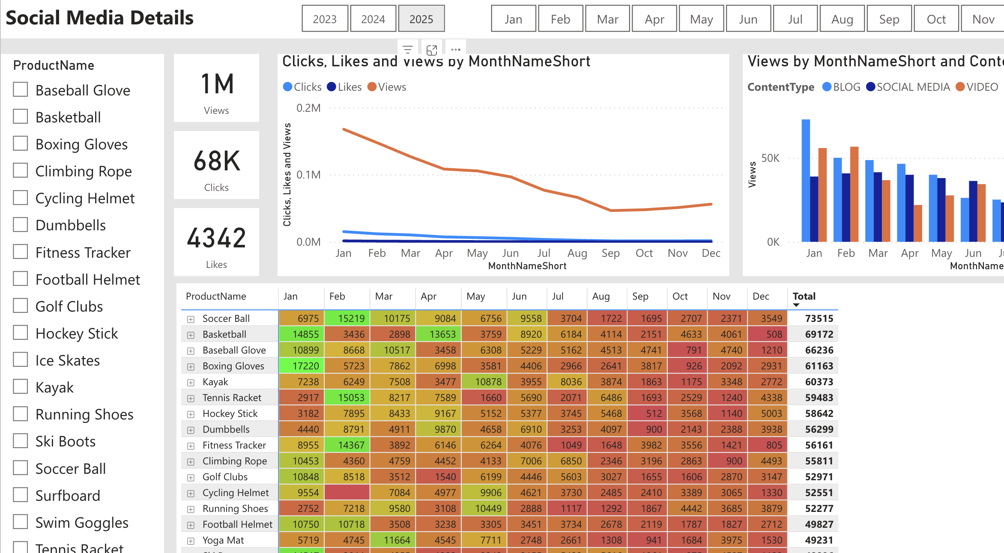
As we can observe from 2023
To 2024 to 2025
Social media interaction can be seen decreasing tremendously.

Slide 6
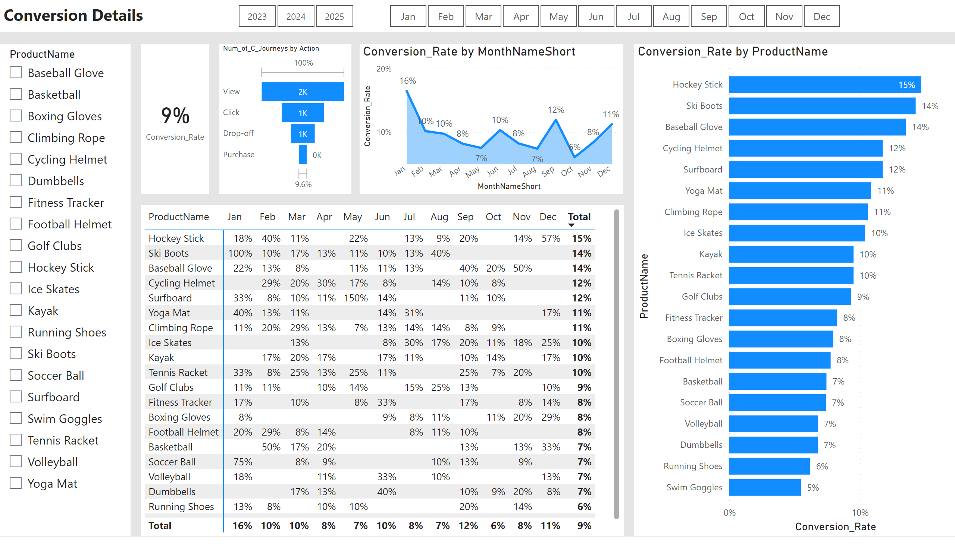
Conversion Details
Notes:
textbox
No alt text provided
slicer
No alt text provided
card
No alt text provided
slicer
No alt text provided
slicer
No alt text provided
lineChart
No alt text provided
clusteredBarChart
No alt text provided
pivotTable
No alt text provided
funnel
No alt text provided

Slide 7
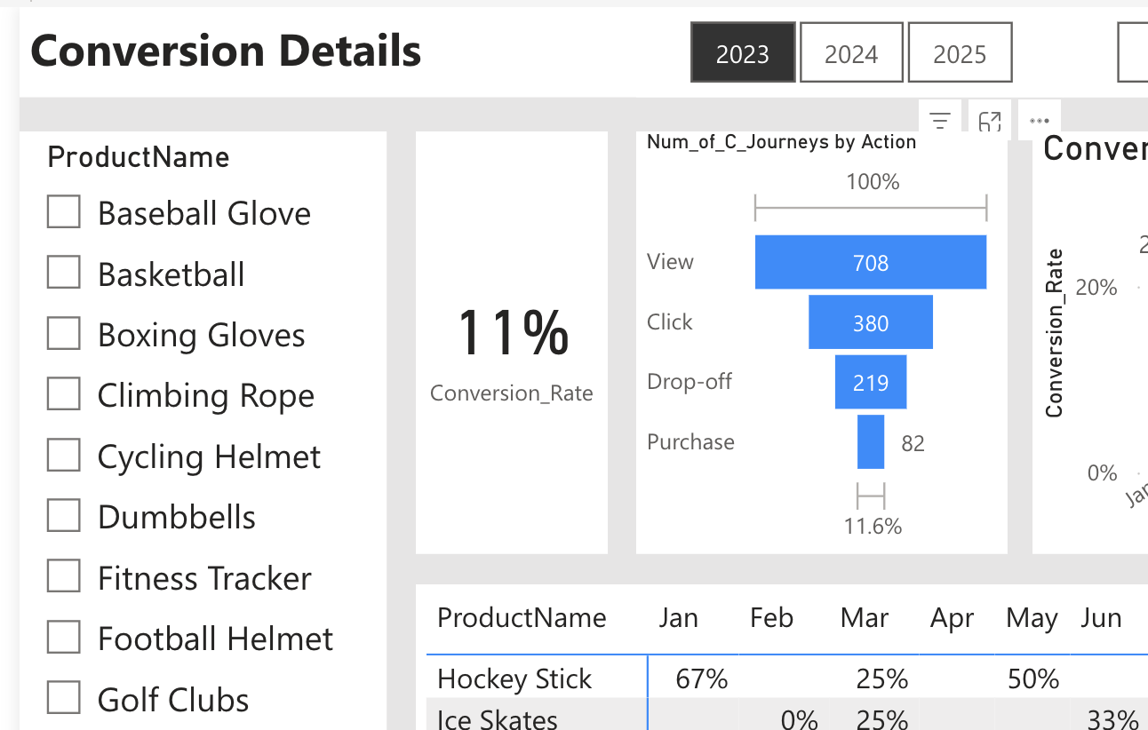
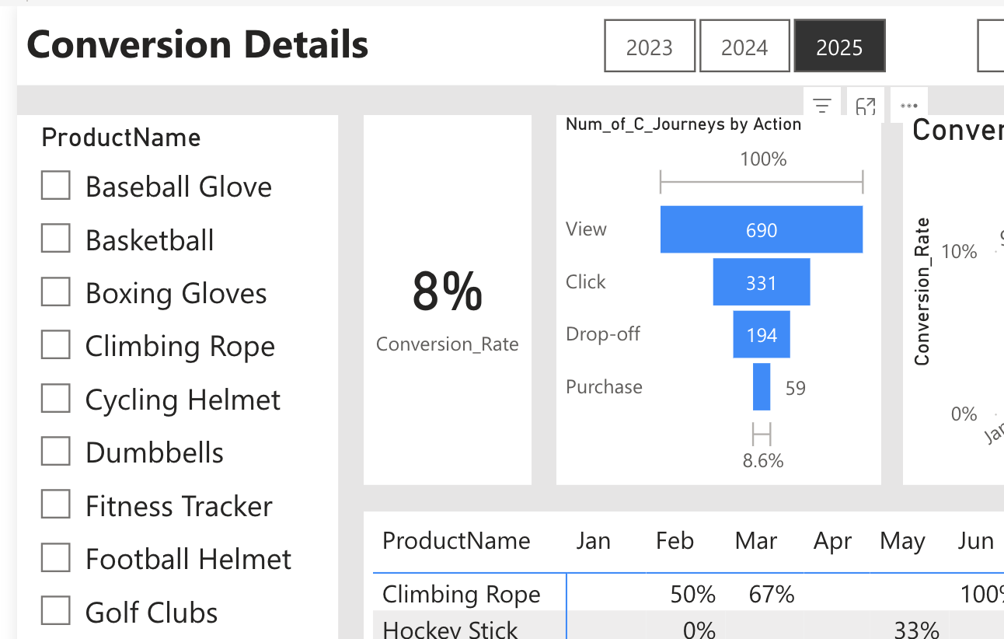
Declined Conversion Rate:
We can observe a 3% reduction in the conversion rate from 2023 to 2025
We can also see drop in the values of views, click, drop-off and purchase from 2023 to 2025
Increase in products like climbing rope, cycling helmet, surfboard can be seen increasing drastically from 2024 to 2025.

Slide 8
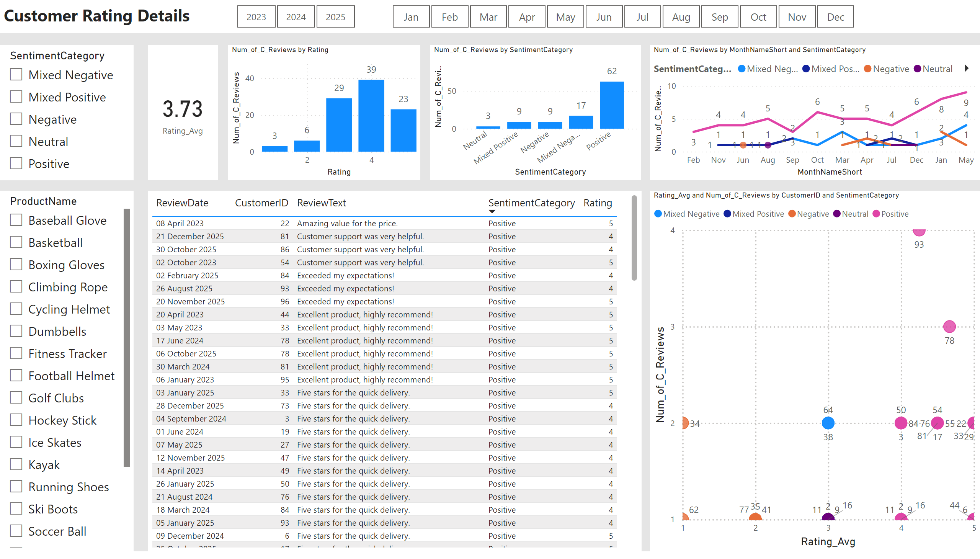
Customer Rating Details
Notes:
textbox
No alt text provided
slicer
No alt text provided
card
No alt text provided
slicer
No alt text provided
slicer
No alt text provided
columnChart
No alt text provided
columnChart
No alt text provided
lineChart
No alt text provided
tableEx
No alt text provided
scatterChart
No alt text provided
slicer
No alt text provided

Slide 9
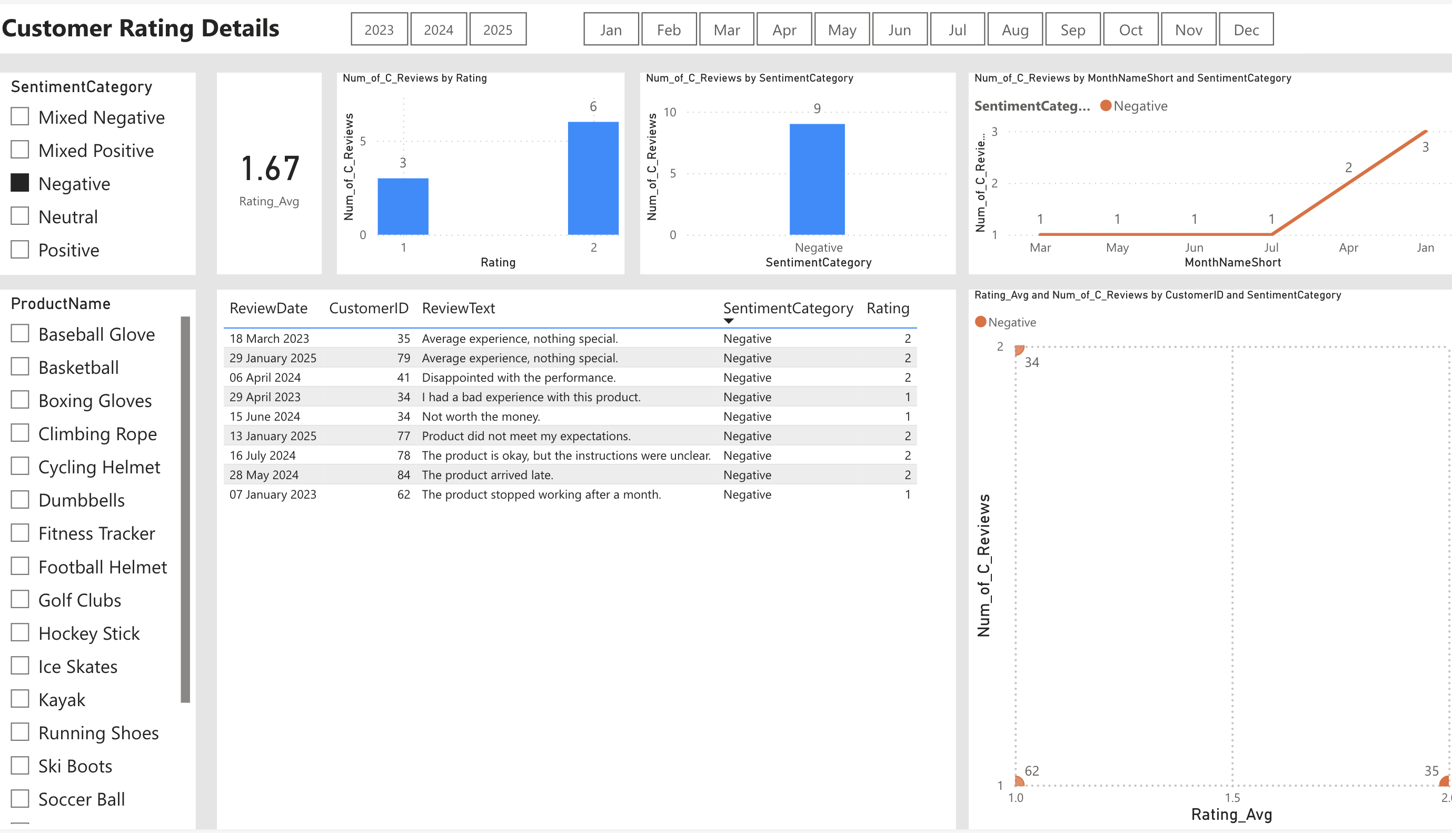
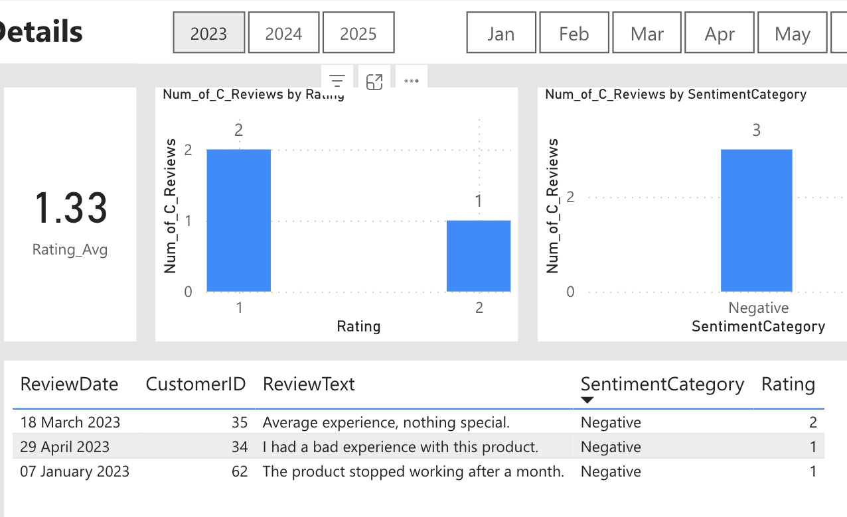
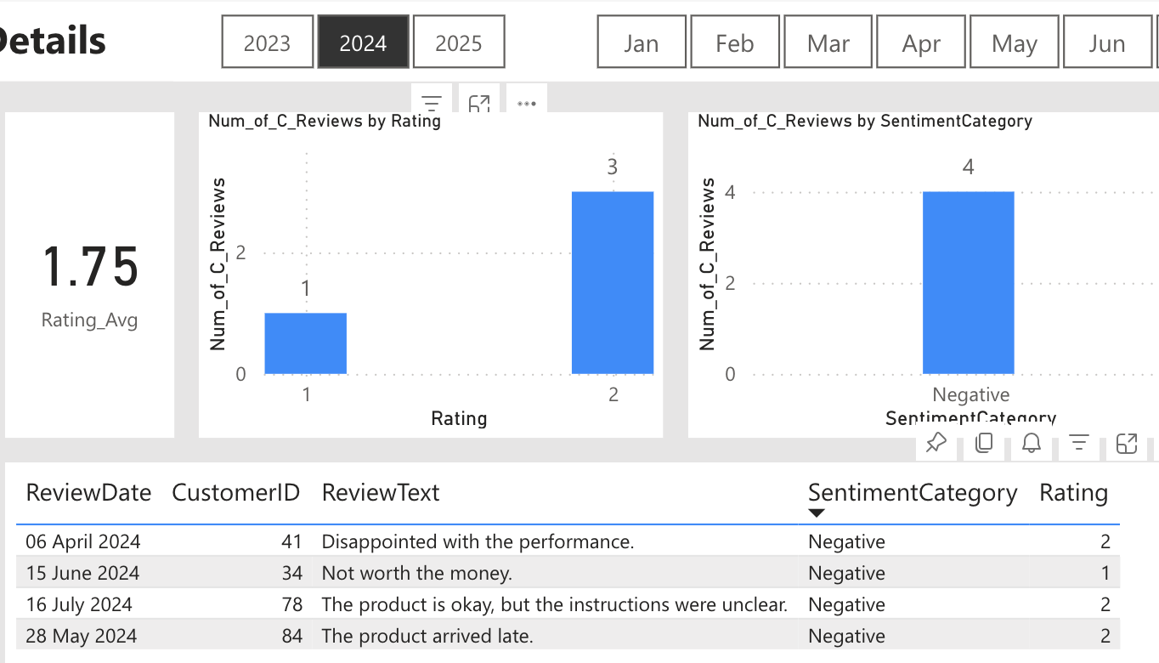
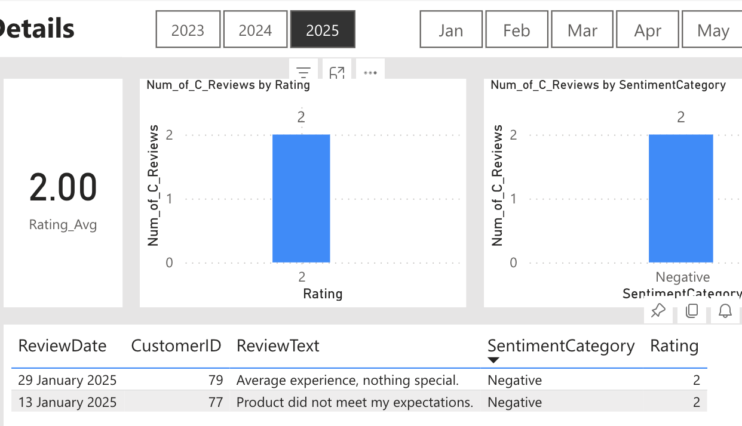
Here we can observe an increase in negative ratings from 2023 to 2025
Negative customer reviews seems to decrease conversion rates over these 3 years

